Slide 1
Chapter 15
The Black-Scholes-Merton Model

Slide 2
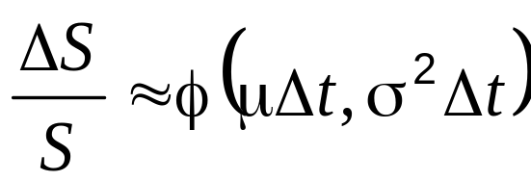
The Stock Price Assumption
Consider a stock whose price is S
In a short period of time of length Δt, the return on the stock is normally distributed:
where μ is expected return and σ is volatility

Slide 3
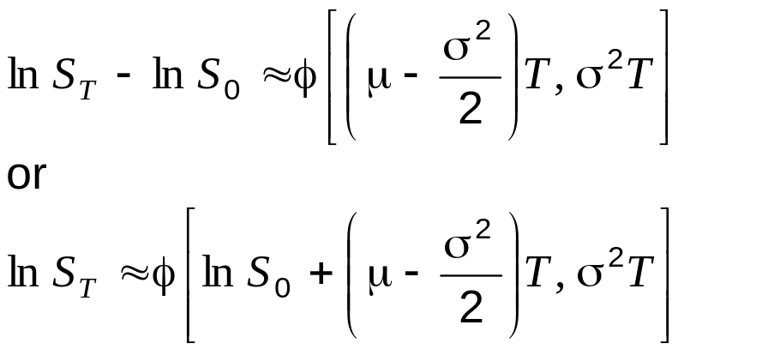
The Lognormal Property
(Equations 15.2 and 15.3)
It follows from this assumption that
Since the logarithm of S_{T} is normal, S_{T} is lognormally distributed

Slide 4
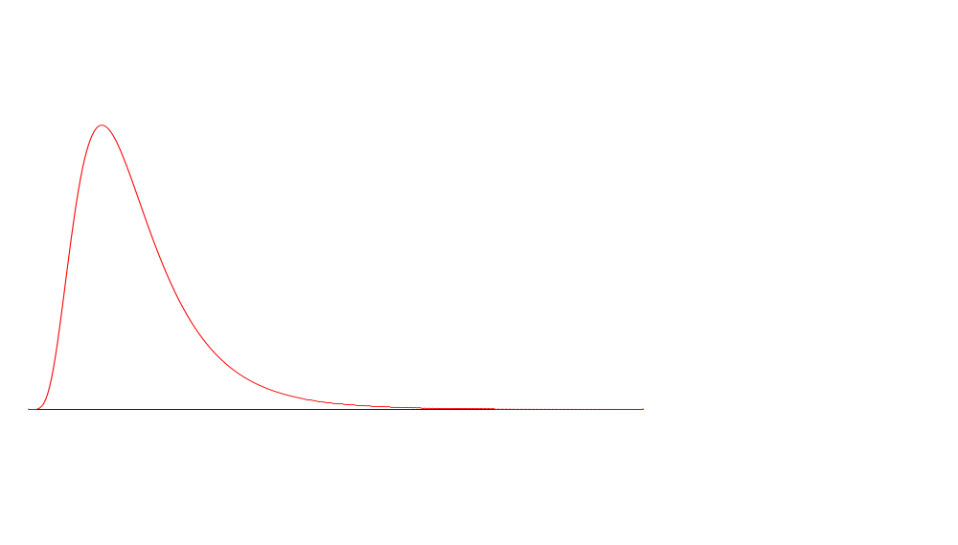
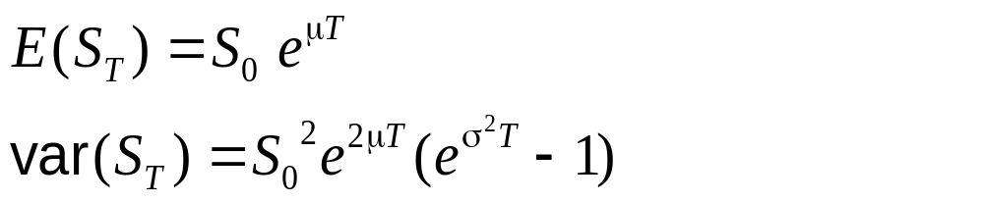
The Lognormal Distribution

Slide 5
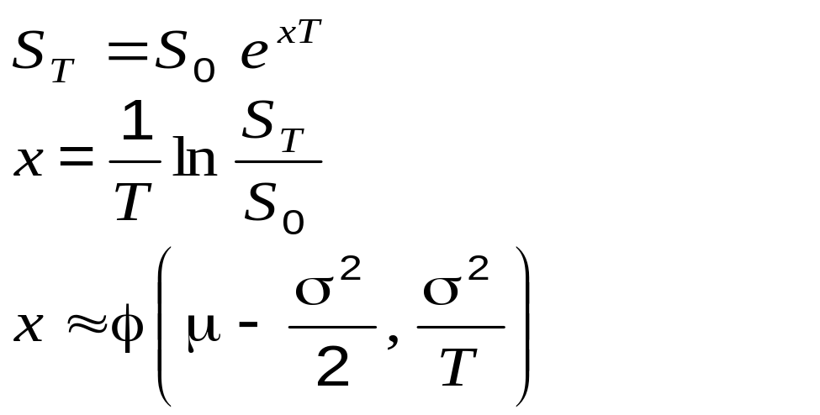
Continuously Compounded Return (Equations 15.6 and 15.7)
If x is the realized continuously compounded return

Slide 6
The Expected Return
The expected value of the stock price is S₀e^{μT}
The expected return on the stock is
μ – σ ²/2 not μ
This is because
are not the same

Slide 7
μ and μ −σ ²/2
μ is the expected return in a very short time, Δt, expressed with a compounding frequency of Δt
μ −σ²/2 is the expected return in a long period of time expressed with continuous compounding (or, to a good approximation, with a compounding frequency of Δt)

Slide 8
Mutual Fund Returns (See Business Snapshot 15.1)
Suppose that returns in successive years are 15%, 20%, 30%, −20% and 25% (ann. comp.)
The arithmetic mean of the returns is 14%
The returned that would actually be earned over the five years (the geometric mean) is 12.4% (ann. comp.)
The arithmetic mean of 14% is analogous to μ
The geometric mean of 12.4% is analogous to μ−σ²/2

Slide 9
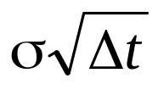
The Volatility
The volatility is the standard deviation of the continuously compounded rate of return in 1 year
The standard deviation of the return in a short time period time Δt is approximately
If a stock price is $50 and its volatility is 25% per year what is the standard deviation of the price change in one day?

Slide 10
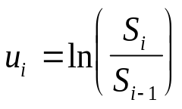
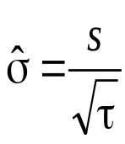
Estimating Volatility from Historical Data
Take observations S₀, S₁, . . . , S_{n} at intervals of τ years (e.g. for weekly data τ = 1/52)
Calculate the continuously compounded return in each interval as:
Calculate the standard deviation, s , of the u_{i}´s
The historical volatility estimate is:

Slide 11
Nature of Volatility (Business Snapshot 15.2)
Volatility is usually much greater when the market is open (i.e. the asset is trading) than when it is closed
For this reason time is usually measured in “trading days” not calendar days when options are valued
It is assumed that there are 252 trading days in one year for most assets

Slide 12
Example
Suppose it is April 1 and an option lasts to April 30 so that the number of days remaining is 30 calendar days or 22 trading days
The time to maturity would be assumed to be 22/252 = 0.0873 years

Slide 13
The Concepts Underlying Black-Scholes-Merton
The option price and the stock price depend on the same underlying source of uncertainty
We can form a portfolio consisting of the stock and the option which eliminates this source of uncertainty
The portfolio is instantaneously riskless and must instantaneously earn the risk-free rate
This leads to the Black-Scholes-Merton differential equation

Slide 14
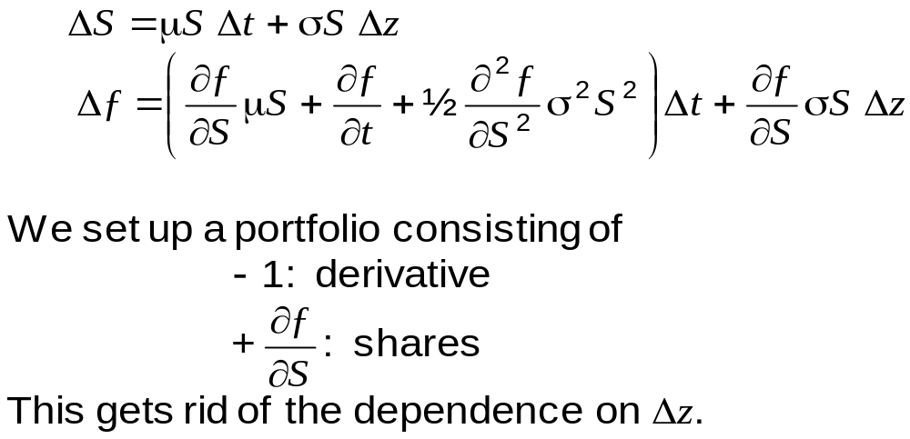
The Derivation of the Black-Scholes-Merton Differential Equation (equation 15.10 and 15.11)

Slide 15
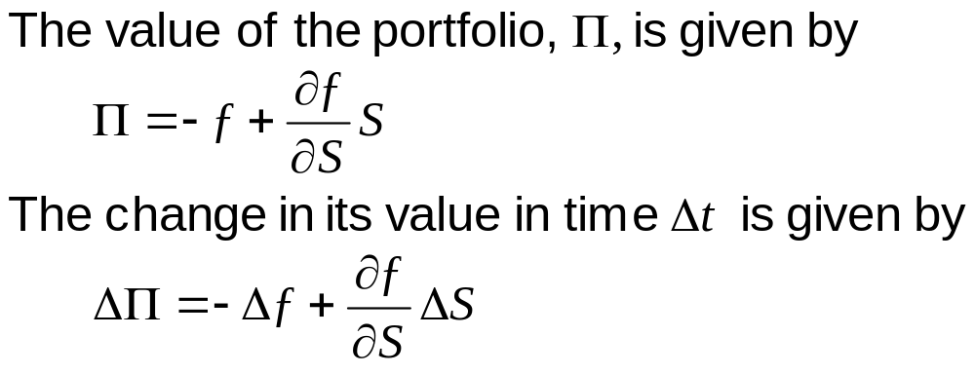
The Derivation of the Black-Scholes-Merton Differential Equation continued (equation 15.12 and 15.13)

Slide 16
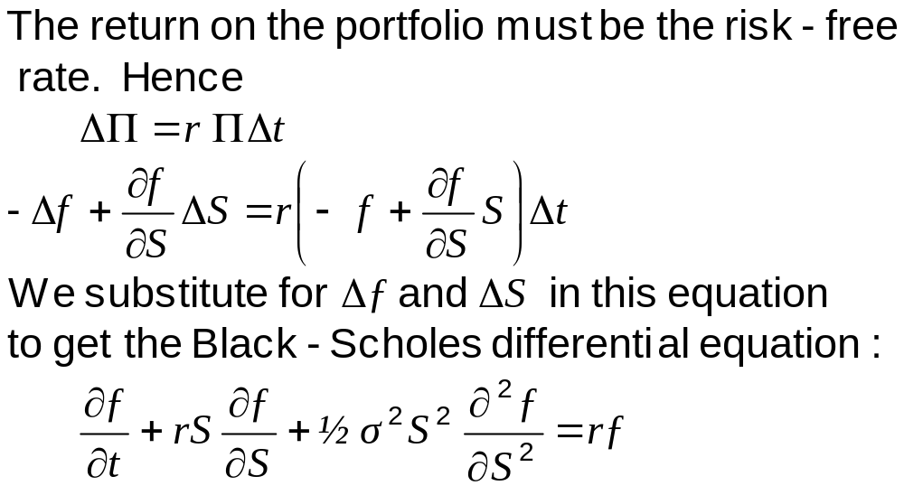
The Derivation of the Black-Scholes-Merton Differential Equation continued (equation 15.15 and 5.16)

Slide 17
The Differential Equation
Any security whose price is dependent on the stock price satisfies the differential equation
The particular security being valued is determined by the boundary conditions of the differential equation
In a forward contract the boundary condition is ƒ = S – K when t =T
The solution to the equation is
ƒ = S – K e^{–r (T – t )}

Slide 18
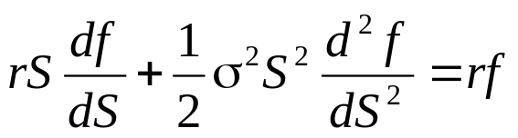
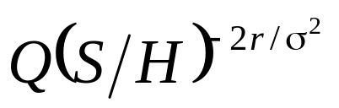
Perpetual Derivative (equation 15.17)
For a perpetual derivative there is no dependence on time and the differential equation becomes
A derivative that pays off Q when S = H is worth QS/H when S<H and when S>H. (These values satisfy the differential equation and the boundary conditions)

Slide 19
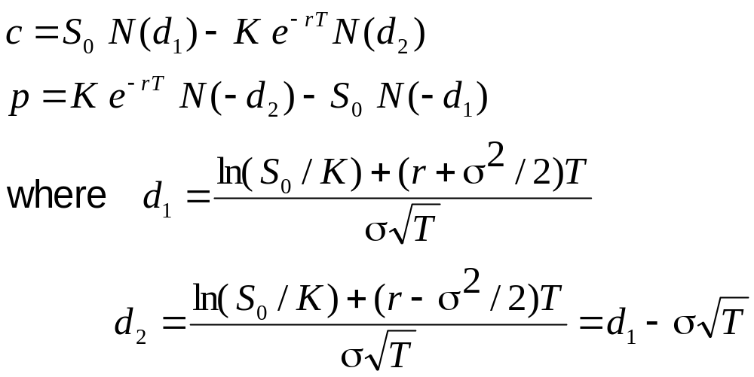
The Black-Scholes-Merton Formulas for Options (equations 15.20 and 15.21))

Slide 20
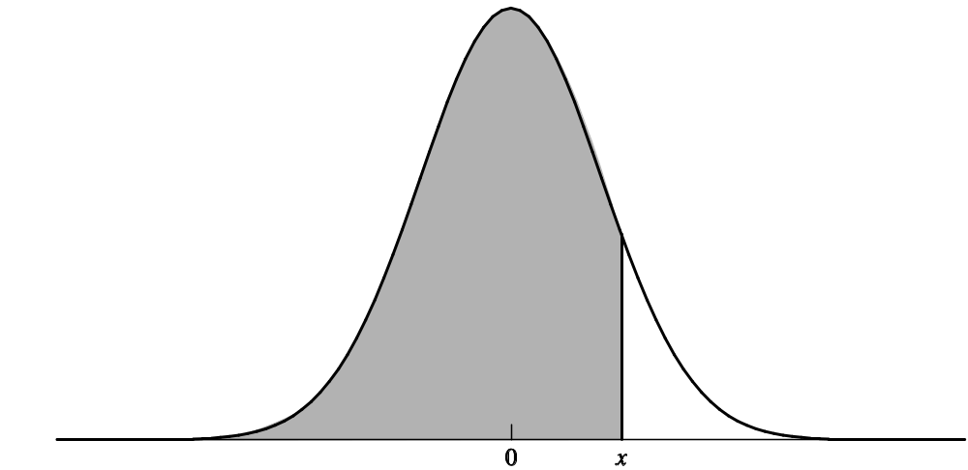
The N(x) Function
N(x) is the probability that a normally distributed variable with a mean of zero and a standard deviation of 1 is less than x
See tables at the end of the book

Slide 21
Properties of Black-Scholes Formula
As S₀ becomes very large c tends to S₀ – Ke^{-rT} and p tends to zero
As S₀ becomes very small c tends to zero and p tends to Ke^{-rT} – S₀
What happens as σ becomes very large?
What happens as T becomes very large?

Slide 22
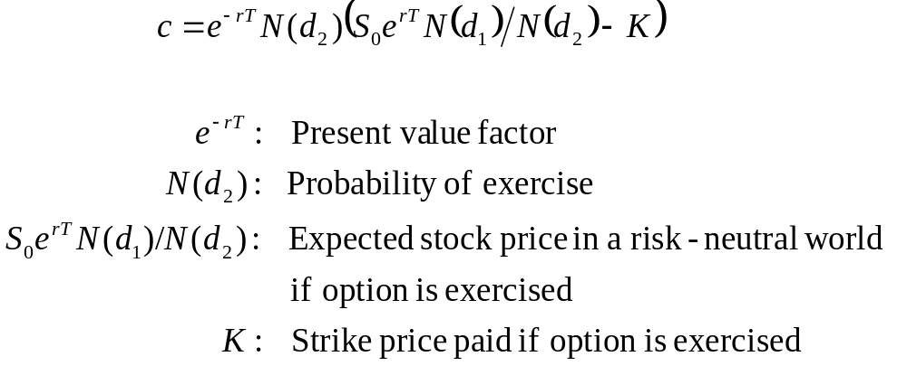
Understanding Black-Scholes

Slide 23
Risk-Neutral Valuation
The variable μ does not appear in the Black-Scholes-Merton differential equation
The equation is independent of all variables affected by risk preference
The solution to the differential equation is therefore the same in a risk-free world as it is in the real world
This leads to the principle of risk-neutral valuation

Slide 24
Applying Risk-Neutral Valuation
1. Assume that the expected return from the stock price is the risk-free rate
2. Calculate the expected payoff from the option
3. Discount at the risk-free rate

Slide 25
Valuing a Forward Contract with Risk-Neutral Valuation
Payoff is S_{T} – K
Expected payoff in a risk-neutral world is S₀e^{rT} – K
Present value of expected payoff is
e^{-rT}[S₀e^{rT} – K] = S₀ – Ke^{-rT}

Slide 26
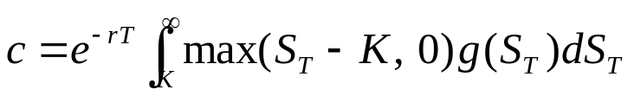

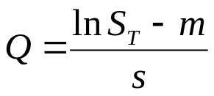
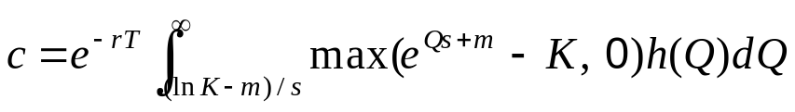
Proving Black-Scholes-Merton Using Risk-Neutral Valuation (Appendix to Chapter 15)
where g(S_{T}) is the probability density function for the lognormal distribution of S_{T} in a risk-neutral world. ln S_{T} is ϕ(m, s²) where
We substitute
so that
where h is the probability density function for a standard normal. Evaluating the integral leads to the BSM result.

Slide 27
Implied Volatility
The implied volatility of an option is the volatility for which the Black-Scholes-Merton price equals the market price
There is a one-to-one correspondence between prices and implied volatilities
Traders and brokers often quote implied volatilities rather than dollar prices

Slide 28
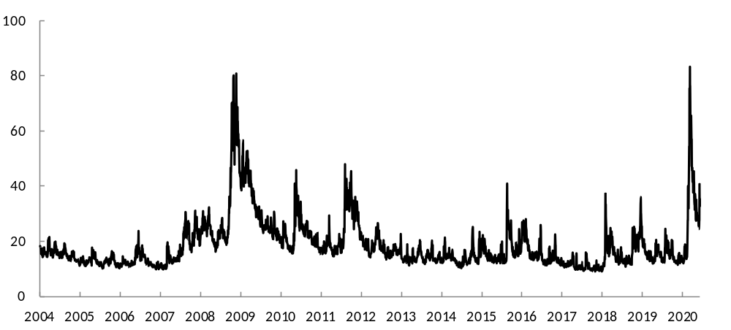
The VIX S&P500 Volatility Index (Figure 15.4)
Chapter 26 explains how the index is calculated

Slide 29
An Issue of Warrants & Executive Stock Options
When a regular call option is exercised the stock that is delivered must be purchased in the open market
When a warrant or executive stock option is exercised new Treasury stock is issued by the company
If little or no benefits are foreseen by the market, the stock price will reduce at the time the issue is announced.
There is no further dilution (See Business Snapshot 15.3.)

Slide 30
The Impact of Dilution
After the options have been issued it is not necessary to take account of dilution when they are valued
Before they are issued we can calculate the cost of each option as N/(N+M) times the price of a regular option with the same terms where N is the number of existing shares and M is the number of new shares that will be created if exercise takes place

Slide 31
Dividends
European options on dividend-paying stocks are valued by substituting the stock price less the present value of dividends into Black-Scholes
Only dividends with ex-dividend dates during life of option should be included
The “dividend” should be the expected reduction in the stock price expected

Slide 32
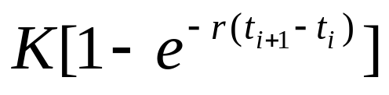
American Calls
An American call on a non-dividend-paying stock should never be exercised early
An American call on a dividend-paying stock should only ever be exercised immediately prior to an ex-dividend date
Suppose dividend dates are at times t₁, t₂, …t_{n}. Early exercise is sometimes optimal at time t_{i} if the dividend at that time is greater than

Slide 33
Black’s Approximation for Dealing with
Dividends in American Call Options
Set the American price equal to the maximum of two European prices:
1. The 1st European price is for an option maturing at the same time as the American option
2. The 2nd European price is for an option maturing just before the final ex-dividend date

